Slide 1
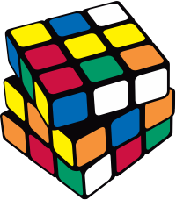
Problem Solving
How to Design Algorithms and Solve Exam Problems?
SoftUni Team
Technical Trainers
Software University
https://softuni.bg
Notes:
Welcome everybody to the "Problem Solving" lesson from the "Programming Fundamentals" course at SoftUni.
I am doctor Svetlin Nakov, a co-founder of SoftUni, and I will be your trainer for this training session.
Problem-solving skills are essential for software engineering, and this is why the software engineering training program at SoftUni pays significant attention to the development of students' algorithmic thinking and problem-solving skills through a large number of practical problems, that are given systematically and with increasing complexity, to consistently build and upgrade these basic skills step by step.
In this lesson I will explain the concepts of "problem solving" and "algorithmic thinking" with examples of technical problems. I will explain the main steps in problem solving, such as defining the problem, analyzing the problem, identifying potential solutions, choosing a solution, designing the algorithm, implementing the algorithm and testing the solution. I will demonstrate how to apply these steps with examples. Finally, I will give tips and best practices for solving problems at practical exams in programming and software development.

Slide 2
Table of Contents
The Fundamental Skills of Software Engineers
Problems: Definition and Problem Solving
Solving Exam Problems: Tips and Best Practices
Sample Exam Problems
Notes:
In my talk I will cover the following topics:
The 4 fundamentals skills, that every software engineer should have:
coding skills (which means writing code, using IDEs, troubleshooting and debugging the code)
algorithmic thinking and problem-solving skills
fundamentals software development and computer science skills
and programming languages, software technologies and frameworks
The definition of "problem", "problem solving", and "algorithmic thinking" and how to develop such skills and how many time and effort it takes.
The main stages of problem solving:
Define the problem
Analyze the problem
Identify potential solutions
Evaluate and choose a solution
Plan actions (or design an algorithm)
Implement the algorithm
And review the results (or test the solution)
These main stages in problem solving will be applied to solving programming exam problems.
I will give you a proven approach, tips and best practices how to be successful at programming exams.
I will explain what to do at the exam and what to avoid, how to analyze tech problems, how to design and implement solutions, and how to do this within a limited time at the exams.
Finally, I will demonstrate the mentioned tips and best practices with real world examples from SoftUni programming exams.

Slide 3
Questions?
sli.do
#fund-common
Notes:
In case you have any question, feel free to ask in the sli.do platform using the code on the screen.
And the trainers will be happy to answer you very soon.

Slide 4

Fundamental Skills of Software Engineers
Notes:
In this section I will explain the four essential skills of software engineers:
Coding skills, algorithmic thinking and problem-solving skills, understanding software engineering concepts and mastering software technologies.
These are the 4 main skill groups that all programmers must have in order to practice software development successfully.
Most of these skills are sustainable over time and are not affected by the advances of the technologies (that are constantly changing).
I will explain in detail these four essential groups of skills, with focus on problem solving and algorithmic thinking.

Slide 5

Skills of the Software Engineers
4 main groups of tech skills:
Coding skills – 20%
Algorithmic thinking and problem solving – 30%
Fundamental software development concepts – 25%
Programming languages and software technologies – 25%
Notes:
There are 4 main groups of skills, that any skillful programmer has and to which every beginner must strive:
Coding skills form 20% of the developer skills.
These coding skills include the following components:
Writing code, using development environments (the so-called IDEs) and developer tools
Working with variables and data, calculations, conditional statements and loops
Using functions, methods, classes and objects
Working with data structures, such as arrays, lists, maps, strings, and trees
Using programming APIs and libraries
Troubleshooting and debugging the code
The skill of coding can be acquired after several months of hard learning and solving practical problems and writing code every day.
At SoftUni the coding skills are mastered at the first few training courses of our end-to-end software engineering program: the "Programing Basics" course, the "Programming Fundamentals" course, and in the next few courses these skills are further developed.
Remember that the programming language does not matter for the ability to code.
Coding is essential skill, which once learned, can be applied in many programming languages.
To master the skill of coding, you need to invest 2-3 months of intensive training and coding every day.
The second essential skill is algorithmic thinking and problem-solving (which forms 30% of the developer skills).
Algorithmic thinking is a way of getting to a solution through the clear definition of the steps needed.
It includes the ability to break a problem into a logical sequence of steps (called "algorithm"), to find a solution for every separate step (or break it further into sub-steps) and then assemble these steps into a working solution.
The algorithmic thinking is similar concept to logical thinking, engineering thinking, mathematical thinking and abstract thinking. All these concepts are related to the ability to solve problems: to think logically, to analyze the problems, and to find and implement solutions.
"Problem solving" is more general skill, while "algorithmic thinking" is more technical (or engineering) skill.
Problem solving is the act of defining a problem; determining the cause of the problem; analyzing the problem; identifying, prioritizing, and selecting alternatives for a solution; and implementing a solution successfully.
In computer science we deal with "technical problem solving", which is the most important skill of any programmer: the ability to solve technical problems by breaking them into sequences of steps and implementing these steps with code.
To master the skill of solving technical problems, it is necessary to invest 6-12 months of intensive training and practicing every day and to solve at least 1000 practical programming problems.
The fundamental computer science and software engineering concepts form about 25% of developer skills.
The fundamental computer science and software development concepts include many programming paradigms, essential software development knowledge and skills, software engineering principles and concepts that developers typically acquire as they gain experience over time.
Some of these knowledge areas and concepts are:
The concept of object-oriented programming (OOP), working with classes, objects, inheritance, interfaces and polymorphism
The concept of functional programming (FP), working with pure functions, declarative programming and immutable data
The concept of asynchronous programming and parallel execution, working with threads, background tasks, promises and others
Databases: relational databases, the entity-relationship model, the SQL language, as well as NoSQL databases, document-oriented databases, the key-value model, database engines, programming APIs and tools for database programming and ORM frameworks
The concepts behind the Web technologies: the HTTP protocol, front-end Web development (HTML, CSS, JavaScript, DOM, AJAX, REST), back-end Web development, MVC frameworks, routing engines, templating engines, cloud technologies, and many others
Software engineering: development methodologies, agile principles, teamwork principles, source control systems, project management principles, quality assurance, and others
The basics of all these software development principles and engineering concepts are learned in the professional modules from the SoftUni curriculum (see softuni.org/curriculum).
It takes 1-2 years of practical software development to learn the basics of these fundamental software development concepts.
Developers learn these concepts in greater detail for many years, as they gain more and more experience during their professional career path.
These concepts are highly stable over the time: once learned, they don't change significantly for decades.
These principles of software engineering and development paradigms are independent of programming languages and specific technologies.
The programming language does not matter for the assimilation of all these skills.
Languages and software technologies (which form only 25% of the developer skills) are what we see at the job offers for developers.
Programming languages (such as JavaScript, C# and Python), software development technologies (such as React, ASP.NET Core and Django), software platforms (such as Java EE and .NET Core), software libraries (such as Apache Commons and ML.NET), development frameworks (such as Spring MVC and Angular) and developer tools (such as npm, Visual Studio, Webpack and Maven) are what we can see in the requirements in most job offers for software developers, but they are the last 25 percent of the developers' skills.
Here are some examples of commonly used software development stacks which software companies are looking for:
C# + object-oriented programming + functional programming + .NET API classes + MS SQL Server database + Entity Framework + ASP.NET MVC + HTTP + HTML + CSS + JavaScript + DOM + jQuery + containers + cloud
Another popular development stack is JavaScript (JS) + functional programming + object-oriented programming + databases + MongoDB or MySQL + HTTP + web programming + web front-end (HTML with CSS, JavaScript, DOM and jQuery or Angular or React) + web back-end (Node.js and Express) + JavaScript tools + cloud + containers
Another popular technology stack from the Python ecosystem is: Python + object-oriented programming + functional programming + databases + MongoDB or MySQL or PostgreSQL + HTTP + web development + HTML + CSS + JavaScript and DOM + jQuery + some MVC framework like Django or Flask + cloud and containers
In the Java space we have development stacks based on the following technologies: Java + Java API classes + object-oriented programming + functional programming + databases + MySQL + HTTP + web programming + HTML + CSS + JS + DOM + jQuery + JSP and Servlets + Spring MVC or Java EE + cloud and containers
These technologies consist of large amount of technical knowledge, which change very fast.
Once you learn a software technology, such as Angular 9 or Java EE 8, it will be outdated in few years or even months and new versions or entirely new technologies will come as replacement. This is normal! Live with the understanding that technology is changing fast. What stays for long are the coding skills, algorithmic thinking and software development concepts and principles.
The usual lifetime of modern software technologies is 2-3 years.
Software technologies are highly dependent on the previous 75% of the developer skills, which are:
Strong coding skills;
Algorithmic thinking and technical problem solving;
Computer science and development concepts;
Some job offers for developers only publish a list of software technologies without even mentioning the coding skills, problem-solving skills and development concepts and principles.
This is because employers assume that all developers should have these 4 groups of skills and that experience with software technologies proves that the applicant has also coding skills, algorithmic thinking and problem-solving skills and understands the concepts and principles behind the modern software technologies.
To be a software developer, you need to have all these 4 groups of essential developer skills. You should learn them: either from your experience, or from trainings and courses, from books or from all these sources combined.
In addition to the tech skills, developers should have also soft skills, such as:
Verbal and written communication skills
Teamwork skills – the skill to work successfully with other people
Organizational skills, time management, planning and prioritization
Accountability, empathy, adaptability, creativity, attention to detail and many others

Slide 6

Algorithmic Thinking
Algorithmic (engineering, mathematical) thinking
The ability to analyze problems and find solutions
Breaking the problem down to steps (algorithm)
How to develop algorithmic thinking?
Solve 1000+ programming problems
It takes 6 to 12 months of coding every day
Courses in SoftUni: Programming Basics, Fundamentals and Advanced Modules
The programming language doesn't matter!
Notes:
For software developers algorithmic thinking and problem-solving skills are essential and we shall explain them in deeper detail.
Algorithmic (or engineering, or mathematical) thinking is the ability to analyze problems and find solutions through the clear definition of the steps needed.
Algorithmic thinking is the skill to break-down a technical problem into steps, which make up an algorithm, and to further break-down these steps into sub-steps (when necessary), and to assemble the solution from the output of the steps performed in the specified sequence.
How to develop algorithmic thinking?
Developing of algorithmic thinking is a process similar to the development of mathematical thinking: you should solve a lot of practical problems: many, many, many problems!
Algorithmic thinking is formed slowly and consistently through a lot of learning, reading about algorithms and data structures, and a large amount of problem-solving practice.
Solve 1000 or more practical programming problems and you will get the foundations of algorithmic thinking.
It takes 6 to 12 months of practical problem solving and coding every day, but once learned, this skill stays for a long time, even for a lifetime.
At SoftUni the algorithmic thinking and problem-solving skills begin to develop during the "Programming Basics" and "Programming Fundamentals" courses and then expand further in subsequent modules and courses in the professional tracks.
The end-to-end software engineering training program at SoftUni will first teach you coding, algorithmic thinking and technical problem-solving skills, and then will continue with modern software technologies combined with basic concepts and paradigms for software development.
Programming languages do not matter for building algorithmic thinking.
You can code in C# or in JavaScript or in the latest top-rated programming language, but with insufficient algorithmic thinking you will be a lamer.
At the same time, you can code in the oldest and ugliest programming language, but with strong algorithmic thinking, your code will be correct, clean, fast and elegant.
From my 20-years teaching experience, I can highly recommend to take enough time to learn algorithmic thinking and problem solving before you start learning the modern software development technologies.
Many "wanna-be-developers" try to learn React or Java Enterprise or other modern technology without having strong coding skills and algorithmic thinking. They fail, because they don't have enough skills and abstract thinking to be able to understand the concepts of the technology and the way it works internally; they don't even understand its syntax.
It is better to spend more time solving algorithmic problems than to be a bad performer or untidy developer later.
People who have strong algorithmic thinking (such as students with experience in programming competitions or top performers in algorithmic classes) have been shown to learn technology very, very fast.
Learn algorithmic thinking and problem solving first!

Slide 7

Tech Problems: Definition and Problem Solving
Notes:
In this section I will explain what a "tech problem" is (by definition) and what a "problem solving" is and how problem solving is related to logical and algorithmic thinking.
I will pay special attention to technical problem solving and algorithm design.

Slide 8
What is a Tech Problem?
Definition – an assignment to design and implement a program, app or software system
Input data + state, output data + state, behavior
Goals – functionality you wish to implement
Calculate the output / implement the behavior
Technical difficulties – barriers, obstacles and limitations to implement the app
Technical knowledge, skills and experience
Notes:
Let's define what is a tech problem – a problem in computing and in the IT industry.
By definition, in our daily live, a problem is a question, situation or a puzzle, requiring logical thought to find a solution.
In physics and mathematics, a problem is a task that starts with certain conditions and aims to find, calculate or demonstrate a fact, result or law.
In programming a problem is an assignment to design an algorithm and implement it by writing code to fulfil certain task.
The assignment can involve taking an input, processing it, and producing an output, or building an application, website, software component or software system.
In most cases the software implements a set of functionality, which have certain input data and program state and produce output data and program state.
Problems have goals.
Goals are what you wish to achieve, the final situation, product, result.
In software development the goals are most often to implement certain functionality.
It can be a simple program, algorithm, component, app or complex software system.
For example, the goals can be to calculate some output from given input or to build an app, which implements certain behavior or set of functionalities.
In math and physics, the goals are to obtain certain result or prove or demonstrate something logically.
In programming, the goals are to design and write a working code, build an app or software system, which corresponds to the assignment and implements its requirements and functionality.
Problems often come with certain technical difficulties: barriers, obstacles or technical limitations to design and implement the required functionality.
These technical difficulties might be shortage of resources or absence of knowledge, skills or experience to build the software or certain functionality.
In the process of problem solving, software engineers research how to overcome the technical difficulties and build the required code or functionality.
Sometimes they need to learn a new programming technique, unknown technology, software library or framework, find a solution in Internet or try several approaches until they find a working solution.
The solution of the problem describes how to overcome the technical difficulties and limitations.

Slide 9
Solving a Problem
Requires a logical thinking (algorithmic thinking)
Define the problem (software requirements)
Analyse and understand the problem
Identify potential solutions (ideas)
Evaluate and choose a solution (try and test)
Plan actions (algorithm design)
Implement the algorithm (coding)
Review the results (testing)
9
Notes:
Solving a problem requires logical thinking (or algorithmic thinking).
It involves many stages like defining the problem; analyzing the problem; identifying potential solutions; choosing a solution; planning actions or algorithm; implementing the actions or algorithm; and reviewing the results or testing.
Defining the problem is the first stage in problem solving.
In software engineering this stage is known as "gathering requirements".
Without well-defined requirements, writing software will be impossible or quite confusing.
For bigger projects there is a role in the project called "requirements analyst" or "business analyst" who works with the customer to collect, analyze and organize the business requirements and describe them in a form, understandable to the technical team.
The next stage in problem solving is to analyse the problem.
This includes to understand deeper the problem, its context, requirements, constraints and obstacles, the people, objects and processes related to the problem and their properties and relationships.
Based on this deep understanding of the problem, we can extract the important information from the requirements and discard the non-important information, and explore the properties of the problem, which will be useful for building a solution.
The next stage in problem solving is to identify potential solutions.
We generate and explore different ideas and technical approaches on how to build a well working solution.
We analyze these ideas, their correctness, their strengths and weaknesses, their practical applicability and the costs of their implementation.
Once we identify and analyze several potential solutions, we evaluate them and choose one of them.
Choosing a solution from several candidates is a decision-making process and depends mainly on the requirements, our capabilities and available resources, as well as the balance between the strengths and weaknesses of the candidate decisions.
In practice, software developers usually try and test several technical approaches until they find one, which works well.
Once we have decided how to solve the problem, we build a detailed action plan (or algorithm).
This plan is a sequence of actions, which we shall execute step by step and description for each action.
We check whether our algorithm (or action plan) is correct and covers all requirements and whether we properly handle all possible situations at each step.
Technically, this means to write the definition of several functions, methods or classes, which will implement the chosen idea.
Sometimes planning the algorithm is done together with its implementation, and there is no clear separation between the stages of algorithm design and algorithm implementation.
Once we have a clearly defined algorithm or action plan, we implement it.
This means executing the planned steps or writing code to execute them.
In software development the implementation process includes also testing and debugging.
The last stage of problem solving is to review the results or test the solution with different input data and entrance conditions.
For software problems and apps, we need to perform testing of the code, feature by feature:
to check for usual and unusual input data and conditions, check for edge cases and special cases.
At this stage you can also ask yourself what has been done well and what can be done better, to learn from the experience.

Slide 10
Tech Problem-Solving Skills
Software developers have strong problem-solving skills
The ability to think logically and solve tech problems
Math thinking / engineering thinking
The ability analyze problems and propose solutions
To design algorithms and to implement them
Algorithm == steps to achieve something
Problem-solving is essential for programming!
Solving math / physics problems at school requires similar problem-solving skills
Notes:
Tech problem-solving skills are what software engineers need to develop in order to be successful in their profession.
At their future job, problem solving will be a daily activity.
And this is the reason why problem solving is an important part of any technical interview.
Remember that skilled software developers should have strong problem-solving skills.
Without strong algorithmic thinking and problem-solving background, a developer will be a low performer, who cannot grow much in the career.
Tech problem-solving is the ability to think logically and solve tech problems.
It is about decomposing problems into sequences of smaller sub-problems (or steps), solving these sub-problems and combining them to assemble the solution of the bigger problem.
These sequences of steps, called algorithms, and their design is the essence of the tech problem solving.
To be able to design algorithms, software engineers need to develop algorithmic thinking, which is also called "logical thinking", "mathematical thinking" or "engineering thinking".
This is a pragmatic solution-oriented thinking approach, which aims to resolve tech problems by executing well-designed sequences of steps.
Tech problem solving is the ability to analyze technical problems and propose solutions, to find how input data or conditions can be transformed through sequence of steps into the output data or conditions, using appropriate tools and resources.
In programming and software engineering, tech problem solving is the ability to design algorithms and to implement them, using programming languages and development tools.
The algorithm (the steps to get the result) is encoded as sequence of commands or programming statements in the code.
The algorithm can be very simple (as if there is no algorithm at all) or it can be quite complex (such that we have to read books or articles on how to design and implement it).
Most everyday tasks that developers work on, require simple sequences of steps and the algorithm design is straightforward.
Remember that problem-solving is essential for programming!
Many candidate developers ask me whether they need strong math skills to become developers and I always answer that they don't need math skills; they need algorithmic thinking and problem-solving skills.
Tech problem solving skills can be developed by solving a few thousand practical programming problems and this is what we do in the end-to-end software engineering learning program at SoftUni.
Solving math or physics problems at school requires similar problem-solving skills, and this is the reason why good mathematicians, physicists and people of scientific or engineering background learn programming and software technologies very quickly.
Remember: it is not required to have strong math skills to become a software developer, but it helps. It helps because math skills include tech problem solving skills and logical thinking.
Learn algorithmic thinking and how to solve technical problems.
Be patient. You will need to solve at least a thousand practical programming problems and spend a few thousands hours in algorithm design, coding and debugging to acquire this skill, but it will be worth for your future tech career.

Slide 11

Solving Exam Problems
Tips and Best Practices
Notes:
In this section, I will give you some tips, ideas, and best practices for solving exam problems, how to prepare for and take programming exams, and how to increase your efficiency and results when you take technical exams for software developers.
These tips and proven practices come from my rich experience as student, contestant and technical trainer, so you can trust them with great confidence.

Slide 12
Read and Analyze the Problems
You are at your "Programming Fundamentals" practical exam
You have 3 problems to solve in 4 hours
First read all the problems carefully and try to estimate how difficult each one of them is (from your perspective)
Read the requirements, don't invent them!
Start solving the easiest / fastest to solve problem first!
Leave the most difficult / slowest to solve problem last!
Approach the next problem when the previous is well tested
12
Notes:
When taking a practical programming exam, the first thing you need to do at the beginning of the exam is to read carefully the problem descriptions and analyze the problems: do you have any idea how each problem can be solved, how difficult each problem is, which is the most easy problem, how many time you expect each problem to take you, etc.
Suppose you are at your "Programming Fundamentals" practical exam at SoftUni.
You have 3 problems to solve in 4 hours.
You receive the problem descriptions of these problems at the beginning of the exam.
My first tip is to:
Start by carefully reading all the descriptions of the problems and try to assess how difficult each of them is (from your perspective).
It is important to read the requirements, not "to invent" them!
This means that instead of guessing about what is required in the problem, you can check the problem description.
Many students begin solving their exam problems before they read carefully the problems, and later they find that they solve the wrong problem.
Estimating how difficult a problem is is only possible when you read the problem description (not only the examples).
Estimate from your point of view!
The problem can be difficult by nature, but it can be very easy for you just because you solved a similar problem the day before.
Another problem can be easy for most students, it can be difficult for you, because you are not strong in this type of problems.
My second tip is to:
Start solving the easiest (or the fastest to solve) problem first!
Don't start with the difficult problems, because you may fail.
You have the biggest chance for success at the exam when you start with the easiest problem first.
Leave the most difficult (or the slowest to solve) problem last!
This means that when you start solving the most difficult problem, you have already solved or did your best to solve the less difficult problems.
Estimate from your perspective what is easy and what is difficult, because you have to solve the problems.
It is important what is easy for you, not for someone else.
Approach the next problem when the previous is well tested or you are confident that your solution is correct (for example, you get the maximum score from an automated exam grading system).
This means that you should put enough attention to testing and polishing your solution.
Often a minor bug can make your solution entirely wrong or drastically reduce your score.
And this can be fixed in just few minutes if you test thoroughly.
Do not skip the testing and bug fixing of your solution, but don't overdo it, because it takes time.
Your exam time is limited, and you should get the maximum score for that time.
Stop testing and bug-fixing after you have covered the typical straightforward cases and the most obvious edge cases, or you have achieved 80% or more from the score from the automated evaluation for the current problem.
You can come back later to fix the bugs and debug the problem to get 100% of the score for it.

Slide 13

Use a Sheet of Paper and a Pen
Never start solving a problem without a sheet of paper + a pen
You need to sketch your ideas
Paper and pen is the best visualization tool
Allows your brain to think visually
Paper works faster than keyboard / screen
Other visualization tools could also work well
13
Notes:
Use a sheet of paper and a pen when you solve programming problems!
Developers need paper, and this is not old-fashioned.
Never start solving a problem without a sheet of paper + a pen.
Trust me. I have very rich experience with programming contests and exams.
Why you need a sheet of paper and a pen?
Because you need to sketch your ideas.
And you should do this fast.
Paper and pen is the best visualization tool.
It works faster than most digital tools.
If you use e-ink or other e-paper technology, that's fine, but overall, traditional paper + pen is the fastest way to sketch ideas.
When you draw or sketch ideas with a paper and pen, you allow your brain to think visually.
Visualization helps a lot with logical thinking.
Complex technical problems are almost impossible to be solved without a sketch, drawing or other form of visualization of the examples.
Paper works faster than keyboard / screen.
And that's why I recommend the old-fashioned traditional paper.
If you use e-paper technology, it will also work well, but visualization in a Photoshop or MS Paint is a bad idea during the exam.
Other visualization tools could also work well.
If you have a specific problem and you have a good tool to visualize it, use it, it's fine.
The important point here is not to lose your time in drawing sketches in the wrong tool or skipping to sketch your ideas.
Use your time wisely: to sketch your ideas, check their correctness, analyze them and choose the best solution approach.
Don't spend your time trying to use the wrong tool!
Visualize your thinking process, sketch your ideas, draw examples and sample input data, think visually.
This will increase your productivity and exam results.

Slide 14

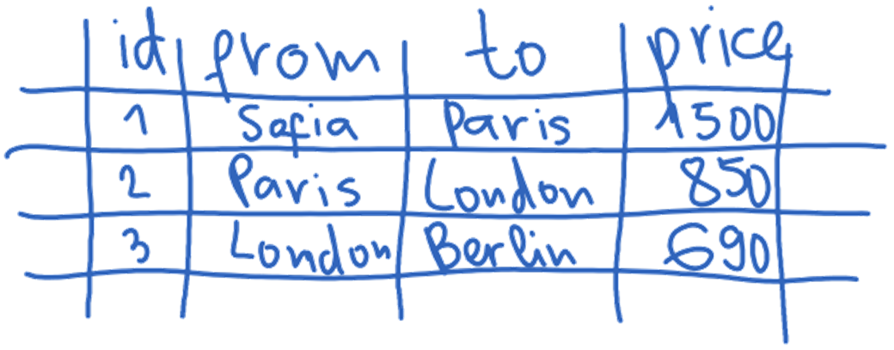

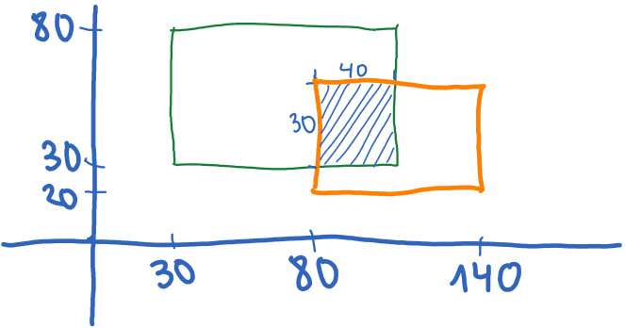
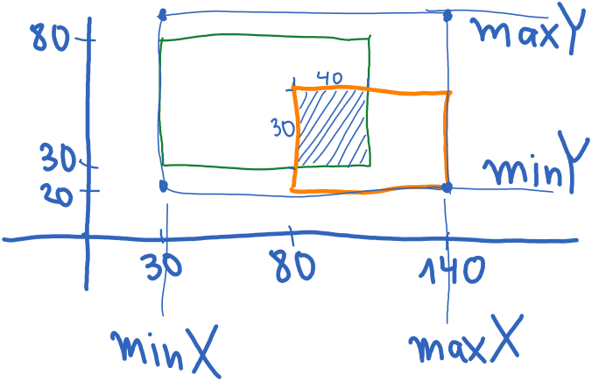
Prefer Squared Paper
Squared paper works best for algorithmic problems
Easy to draw a table
Easy to draw a coordinate system with objects in it
Easy to calculate distances
Easy to sketch a problem and solution ideas
Use pens of different colors
14
Notes:
Prefer squared paper!
It works better for sketching and visualizing your ideas.
Squares helps building drawings, sketches, diagrams, and plans
Squared paper works best for algorithmic problems.
Squared paper allows to draw tables easily.
In many programming problems you need tables.
In this example you have a pricing table consisting of 4 columns ("id", "from", "to" and "price") and 3 rows, which contains prices between pairs of cities.
It is easy to draw a coordinate system with objects in it.
In many programming problems you need a coordinate system.
In graphical user interface (GUI) apps you may need a coordinate system to sketch the user interface.
In this example we have a drawing of two rectangles on the coordinate system and their intersection.
On a sheet of squared paper it is easy to calculate distances.
In many cases distances between objects on the squared paper are visually obvious.
The most important use of squared paper is to easily sketch a problem and solution ideas.
The important point is that you want to be quick in sketching and testing ideas.
You have limited time for the exam, and you must use it wisely.
In this example we have sketched an idea how to find the left, right, top and bottom sides of the objects in the coordinate system.
If you have pens of different colors, take them for the exam.
Some ideas can be illustrated better with different colors.
I personally use only one color, because it takes time to change pens, but it's personal. Some colleagues quickly create excellent drawings using several colors.

Slide 15
Managing Your Time
At the exam you have limited time!
Start with the problem, which will take you the least time
Then, again the problem, which will take you the least time
When you achieve a result of 80/100 or 90/100
Think carefully for the edge cases → try to handle them
After you spend 10-15 minutes on the last few tests, stop!
Don't spend hours for the last 10% of the tests!
Achieving a score of 80-90% of 3 problems is better than 100% of just 1 problem
Notes:
Exam time management is crucial to the success and achievements of the exam.
Remember that at the exam you have limited time!
Start with the problem, which will take you the least time.
This is usually the easiest problem, but it depends on your experience and previous exam preparation.
If you want to achieve the highest possible exam result, you should solve the least time-consuming problem first.
Then, proceed with the problem, which will take you the least time, again.
If you have one problem solved, start solving the least time-consuming problem as a natural next step.
If you take a problem, which is too difficult or time-consuming, you may spend all your time on it and fail the exam.
When we solve problems, it is usual to write almost correct solution, that works the most input cases, but not for all.
At this moment you start debugging and bug fixing in order to improve your solution.
Looking for bugs, debugging and bug fixing can be an almost endless process.
It is quite important to know when to stop!
Otherwise you risk to spend all your exam time on debugging the first problem, instead of solving the other problems.
My tip is when you achieve a result 80 out of 100 or higher for certain problem, to do the following:
Think carefully for the edge cases and try to handle them.
Usually your program will fail for some edge case.
For example, if you have an array of numbers as input, try an empty array or an array of just one element.
Check the ranges of the input data in the problem description (if available) and try testing your code with input, which is close to the limits.
Important: after you spend 10 to 15 minutes on testing and debugging the edge cases or trying to find why your solution is not entirely correct, stop!
Just stop losing your time. Spend your time on the next exam problems instead on a small portion of the current problem.
Don't spend hours to pass the last 10% of the tests!
This is a very common mistake. Don't do it!
Achieving a score of 80% to 90% of 3 problems is much better than 100% of just 1 problem.
I have seen many times at the exams at SoftUni how students spend all their time trying to achieve 100% of the first problem and after 3 or 4 hours they say "I didn't have time for all the problems. The exam was very difficult." or "I had a bad luck: I spent most of my time to find a stupid bug, which I finally fixed, but I didn't have time for the other problems."
Don't do this! After you solve problem incompletely, give it some time for the edge cases and troubleshooting, but limit this time to 15 minutes!

Slide 16
Typical Mistakes at the Exam
Wrong approach #1: start coding at the first 5 minutes
These students have not read the problems (and will fail)
They don't start with the easiest problem, but with the first one
Wrong approach #2: don't use pen + paper
These students try to invent solutions in their minds
Instead of visualizing their ideas on a sheet of paper
Wrong approach #3: debugging in your mind
Trying to find the bugs by reading the code
This is wrong: you have a debugger in your IDE!
Notes:
Now I am going to discuss with you the most common typical mistakes at the programming exams.
This list of common mistakes comes from my practical experience.
I share it with you, because I want you to learn from my rich experience at programming contests and exams.
Wrong approach #1: start coding at the first 5 minutes
I have seen this many times. Students, who start coding in the first 5 minutes, usually fail at the exam.
These students have not read the problems. How can you read the problems carefully so quickly?
These students don't start with the easiest problem, but with the first one. This can be wrong in most cases.
Starting coding too quickly means that you have skipped reading the problem description and have skipped doing the problem analysis and sketching the ideas, to select and implement the best idea.
An exception may be when you are very well prepared and there is no difficult problem for you: all problems are equally easy for you. In this case you can solve the problems as they are given: first, second, third, etc.
Wrong approach #2: don't use pen and paper
Students who come at the exam without pen and squared paper (or any other paper), will most probably fail.
These students try to invent solutions in their minds instead of visualizing their ideas on a sheet of paper.
This is very, very wrong!
Use your visual brain in the problem-solving process. Sketch your ideas using the fastest drawing tool: paper and pen.
Wrong approach #3: debugging the code in your mind
When a bug appears, many students try to find the bug by carefully reading the code.
This may help, but using the build-in debugger is much, much better.
You have a debugger in your IDE (the integrated development environment such as Visual Studio or Eclipse).
Learn how to use the debugger! This makes the difference between lamer and real programmer.
Debugging the code means to execute it line by line or use breakpoints to stop at the interesting lines of code and to monitor the values of the working variables during the execution. This will allow you to easily find the bugs in the code.
Students, who don't use the debugger at the programming exams, rarely have high results.
Learn to use the debugger! This is a critical skill if you want to be a developer.

Slide 17
Typical Mistakes at the Exam (2)
Wrong approach #4: spend all the time at the first problem
Some students spend 4 hours at the first problem
This is wrong: when you spend 1 hour at certain problem, without a significant progress → go to the next problem!
You can go back to the first problem, after you solve the others
Wrong approach #5: spend hours trying to fix a bug
Some students spend hours to move from 90% to 100% for the first problem and never start the next problem
Move on the next problem shortly after you reach 70%-90% of the score!
Notes:
Wrong approach #4: spend all the time at the first problem
This is quite common, and I have already explained it several times.
Some students spend 4 hours or even more at the first exam problem.
This is wrong: when you spend 1 hour at certain problem, without a significant progress, go to the next problem!
You can go back to the first problem later, after you solve the others.
Spend some time working on the other problems. You will probably have better success with them.
Sometimes our brain get stuck and we cannot continue thinking, generating new ideas or finding why our code does not work.
It may happen to everyone.
In this moment you should change the thinking context (by switching to another problem) or take a short break.
Wrong approach #5: spend hours trying to fix a bug
Some students spend several hours to move from 90% to 100% for the first problem and never start solving the next problem.
This is wrong! It's better to have several incompletely solved problems, instead of only one problem solved 100%.
My tip here is to move on to the next problem shortly after you reach 70% to 90% of the score (after 10 to 15 minutes of troubleshooting)!

Slide 18
Typical Mistakes at the Exam (3)
Wrong approach #6: don't take a break, when you block
Everyone can block, get nervous, or become distracted
Take a short break, go outside, breathe, calm down
Wrong approach #7: come to the exam unprepared
Prepare yourself, study hard, practice a lot, solve sample exams
You are ready, when you can solve any previous exam for 1-2 hours
Wrong approach #8: trying to cheat
Many students try to cheat (e.g. use help from friends)
Cheating is bad for you! Who will do your future job?
Notes:
Wrong approach #6: don't take a break, when you block
Everyone can block, get nervous or get angry, or become distracted. It happens.
In such a situation, take a short break, go outside, breathe and calm down.
Instead of working in an unproductive mental state, try to change it.
Wrong approach #7: come to the exam unprepared
Coming without preparation for the programming exam is a big mistake.
Even if you are smart and have strong programming skills, you need preparation.
You need to practice solving problems, like at the exam.
Prepare yourself, study hard, practice a lot, solve sample exams!
The best way to prepare for particular exam is to solve the previous editions of the same exam.
Find exam topics from previous classes and solve them.
You are ready, when you can solve any previous exam for a maximum of half the time allowed.
If you can easily solve the exams from previous years for 1-2 hours (out of the allowed 4 hours), you are ready.
Wrong approach #8: trying to cheat
Many students try to cheat at the exam, but this is a bad idea.
Examples of cheating include getting help from friends or colleagues,
sharing solutions' code with friends or neighbors,
taking solutions from a friend or colleague,
working together with friends in a group at the individual exams
and many others
The cheating techniques depend on the exam and the way it is conducted.
Nevertheless, cheating is bad for you!
With cheating you can go ahead without learning what you are supposed to learn,
and the next training course will be too difficult for you.
If you have luck and you are not caught for cheating several times in a row, until you graduate what shall you do at the job interview?
How shall you demonstrate what you have learned?
Who will do your future job?
Don't cheat at the exams. It is bad for your future.

Slide 19


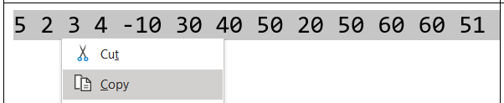
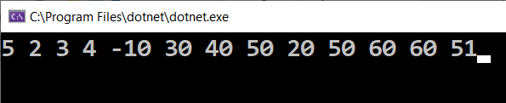
Typical Mistakes at the Exam (4)
Wrong approach #9: working without a mouse
Use the mouse, not a touchpad!
Mouse works more precisely
Mouse saves time and effort
Wrong approach #10: typing the sample input examples by hand
Use copy/paste for the input examples!

Slide 20

Sample Exam Problems
Following the Best Practices
Notes:
Now we shall illustrate the exam problem-solving best practices by a few examples.
We will consider several technical exam problems.

Slide 21
Tech Problem: Longest Palindrome Sub-List
We are given a list of letters
We want to find the longest sub-list, which is a palindrome (reads the same backward as forward)
Examples:
a
b
b
a
b
b
x
b
a
5
a
b
b
a
4
a
b
c
c
d
2
a
h
c
h
x
x
u
3
a
h
c
h
x
x
h
4
Notes:
I have a tech problem from a practical programming exam for you:
Finding the largest palindrome sub-list in given list.
Unlike previous problems, this one is purely programming challenge.
We are given a list of letters.
We want to find the longest sub-list, which is a palindrome.
A list is palindrome, if and only if it reads the same backward as forward.
For example, "a b b a" is palindrome, but "a b c" is not palindrome.
Examples:
In the list "a b b a b b x b a" the largest palindrome sub-list is "b b a b b" and its length is 5.
The sub-list "b b a b b" reads the same forward and backward, so it is a palindrome.
In the list "a b b a" the largest palindrome is "a b b a" and its length is 4.
The entire input list is a palindrome.
In the list "a b c c d" the largest palindrome sub-list is "c c" and its length is 2.
The sub-list "c c" reads the same forward and backward, so it is a palindrome.
In the list "a h c h x x u" the largest palindrome is "h c h" and its length is 3.
The sub-list "h c h" reads the same forward and backward, so it is a palindrome.
In the list "a h c h x x h" the largest palindrome is "h x x h" and its length is 4.

Slide 22
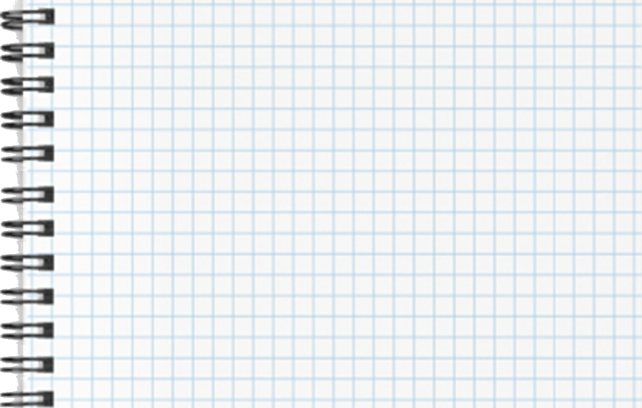

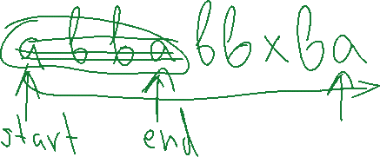


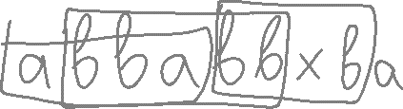



Take a Pen and Paper and Visualize Ideas
Notes:
Take a pen and paper and visualize your ideas. This is how it could work.

Slide 23
Longest Palindrome Sub-List: Analysis
Problem analysis: 2 types of palindromes
Odd-length (single letter at the center)
Even-length (two letters at the center)
a
b
b
a
b
b
x
b
a
5
x
x
x
h
3
a
b
b
a
4
a
h
c
c
h
x
u
3
Notes:
Now it's time to solve the "Longest Palindrome Sub-List" problem.
First, let's define the problem. We should have clear requirements.
We are given a list of letters.
We have many sub-lists in the input list.
Some of them are palindromes.
Our goal is to find the longest palindrome.
Let's see some examples:
In this example we have a palindrome of length 2.
And there is no other longer palindrome.
In the following example, we have a list that is itself a palindrome, and its length is 4.
In this example we have a palindrome sub-list of length 3.
Here we have a palindrome sub-list of length 5.
The next stage of problem solving, after defining the problem and its requirements, is the problem analysis.
It is important to notice that we can have 2 types of palindromes: odd-length and even-length.
Odd-length palindromes have one letter at the middle and the other letters are symmetrical around this letter. We call this scenario "single central point".
Even-length palindromes have two letters at the middle and the other letters are symmetrical around these two letters. We call this scenario "double central point".
These two cases might be handled by the same algorithm or separately with different algorithms. We shall see later, but it is good that we have examples of both cases.

Slide 24
Largest Palindrome Sub-List: Solutions
2
3
Potential solutions:
Find all possible start + end positions and check for palindrome
Find all possible single central points and double central points and check for palindrome around them
Find all sub-lists of size n (the length of the input list), then of size n-1, n-2, …, 1 and check for palindrome each sub-list
Can we find the length of the longest palindrome without checking all palindromes in the list? → Yes, solution #3
Which is the most efficient solution? → solution #2
a
b
c
c
d
b
c
d
c
Notes:
The next stage in problem solving is to identify potential solutions:
Solution #1 is to find all possible start + end positions and check for palindrome.
The start can be any position and the end can be any position which is on the right from the start or is the start itself.
This way we can find all sub-lists inside the input list.
We can check each sub-list whether it is a palindrome or not:
We check whether the letter at the start position and at the end position are the same.
We move the start to the right and the end to the left and we compare the letters at these positions again.
We repeat the same until the end moves before the start. This will mean a palindrome.
If we find different letters at the start and the end positions at some moment, this means the sub-list is not palindrome.
Finally, we can take the longest of all the palindromes we have found.
Solution #2 is to find all possible single central points and double central points and check for palindrome around them.
We can assume each letter is a single central point. We can start from it and find how long palindrome we have.
We can go left and right while possible and compare the letters: left and right.
If the letters are the same, we still have a palindrome. If the letters are different, the palindrome has ended on the previous step.
We assume that each sequence of two consecutive equal letters is a double central point. We can start from it and find how long palindrome we have.
We can go left and right while possible and compare the letters: left and right.
If the letters are the same, we still have a palindrome. If the letters are different, the palindrome has ended on the previous step.
This algorithm will find all palindromes and we can take the longest of them.
Solution #3 is to find all sub-lists of size n (the length of the input list), then all sub-lists of size n-1, n-2, and so on, until 1 and check for palindrome each sub-list.
The first palindrome we find will be the longest palindrome.
We have 3 candidate-solutions. Can you find more?
You can try to find a different algorithm.
I think that these 3 algorithms are enough for now.
I ask myself the following question: can we find the length of the longest palindrome without checking all palindromes in the list?
This can potentially be the fastest solution, because it does not scan all possible palindromes.
Only solution #3 does not find all the palindromes, but only the longest one. Unfortunately, it is not fastest solution, because in the worst case it will check all possible sub-lists in the input list.
Now, let's think which is the most efficient solution?
The efficiency can be different for these 3 solutions.
Solution #1 finds all possible sub-lists (which are of the order of n*n/2) and checks each sub-list for palindrome (which takes single scan through its letters). The total number of operations are of the order of n*n*n/2, (where n is the length of the input list).
Solution #2 takes each letter and each two consecutive equal letters as central point and scans around it for palindromes. Finding all central points takes a single scan through the letters. Scanning for palindrome around given central point takes a single scan of maximum n letters. Hence, the total number of operations are of the order of n*n.
Solution #3 finds all possible sub-lists (in the worse case, when which there are no palindromes of length bigger than 1) and for each sub-list performs a palindrome check. Therefore, the total number of operations are of the order of n*n*n/2.
Looks like the solution #2 is n times faster than the others and it is the most efficient solution among the candidates.
We choose to implement it, because it is easy to understand and implement and has better performance than the other candidate solutions.

Slide 25
Largest Palindrome Sub-List: Algorithm
Algorithm (sequence of steps) for solution #2:
Choose each letter as central point and count how many letters around it form a palindrome
Choose each two consecutive equal letters as central point and count how many letters around them form a palindrome
Choose the longest among all palindromes found
h
h
x
h
x
h
5
a
h
c
c
h
x
u
4
Notes:
So far, we have analyzed the problem, generated ideas for solutions and chosen the most reasonable idea. It is time to describe in more detail the algorithm behind this idea.
The algorithm (the sequence of steps) for solution #2 is the following:
Choose each letter as single central point and count how many letters around it form a palindrome.
This is an illustration of how this works:
"h" as central point: this is the palindrome around it. It has a length of 1.
The next "h" as central point: this palindrome has a length of 1.
"x" as central point: the palindrome around it has a length of 3.
The next "h" as central point: the palindrome around it has a length of 5.
The next "x" as central point: the palindrome around it has a length of 3.
The last "h" as central point: its palindrome has a length of 1.
We choose the longest among all palindromes found: it is 5 for our example.
Counting the palindrome length around given start and end position can be done by comparing the letter at the start with the letter at the end position while possible and moving the start position right and the end position left when the letter is the same. When the letter is different or the right position goes before the left, or the left position or the right position goes outside of the list, we stop. At the end, the difference between the start and the end positions corresponds to the longest palindrome length for the given central point.
We need to handle also the second type of palindromes, which have double central point.
We can choose each two consecutive equal letters as central point and count how many letters around them form a palindrome.
Counting the palindrome length around given start and end position is the same for this case. Only the start and the end positions are different.
This is an illustration of how we can process all double central points:
We try to take "a" and "h" as central point. We have no palindrome around them, because they are different letters.
Next, we try to take "h" and "c" as central point. Different letters. There is no palindrome.
Now we take "c" and "c" as central point. We find a palindrome of length 4 around this central point.
Next, we try to take "c" and "h" as central point. Different letters. No palindrome.
"h" and "x": no palindrome.
"x" and "u": no palindrome.
This algorithm will find all palindromes around every possible central point (single or double). Finally, we must choose the longest of all palindromes found.

Slide 26
Largest Palindrome Sub-List: Implementation
int PalindromeLen(int leftIndex, int rightIndex)
{
while (leftIndex > 0 && rightIndex < letters.Length
&& letters[leftIndex] == letters[rightIndex])
{
leftIndex--;
rightIndex++;
}
return rightIndex - leftIndex - 1;
}
a
h
c
c
h
x
u
4
leftIndex
rightIndex
Notes:
We have a clear idea how to solve this problem and we have prepared a detailed description of the algorithm. It is time to implement the algorithm, to write the code.
The function PalindromeLen takes leftIndex and rightIndex as parameters.
It calculates the length of the palindrome, which has a central point at the specified start and end positions.
The left index and the right index could be the same. This is the case with single central points.
The other case is when the left index and the right index differ by 1. This is the case with double central points.
How does this function scan for palindrome around given start and end?
While both indexes are within the list (not outside) and we have equal letters at these indexes, we increase the right index (move it right) and decrease the left index (move it left).
This ends at different letters or when the end of the list is reached.
The returned output is calculated as the difference between the right index and the left index minus 1.
Why? Because when we find the first difference, the palindrome has already ended in the previous step.
This function will return 1 for single central points which have no symmetric letters around them. And this is correct.
This function will return 0 for double central points which consist of different letters. And this is also correct.
This function will return 4 for the example at the screen (where the left index starts from 2 and the right index starts from 3).
It starts from comparing "c" and "c". Equal letters. The left index goes left, and the right index goes right.
The next letters to compare are "h" and "h". Equal letters. The left index goes left again, and the right index goes right again.
Now the next letters to compare are "a" and "x". Different letters. The loop now stops.
The returned result is: the right index (which is 5) minus the left index (which is 0) minus 1, which calculates to 4.
The function returns 4. This is the length of the palindrome around the letters "c" and "c" used as central point.

Slide 27
Largest Palindrome Sub-List: Implementation
string letters = Console.ReadLine();
int maxLen = 0;
// Check all single letter central points
for (var c = 1; c < letters.Length; c++)
maxLen = Math.Max(maxLen, PalindromeLen(c, c));
// Check all double letter central points
for (var c = 1; c < letters.Length-1; c++)
maxLen = Math.Max(maxLen, PalindromeLen(c, c+1));
Console.WriteLine(maxLen);
Notes:
Now it will be easy to implement the "longest palindrome sub-list" algorithm using the PalindromeLen function.
We read the input list.
We first check all possible single letter central points and we remember the length of the longest palindrome around a single central point.
We invoke the PalindromeLen function, and we pass to it the central point c, as start and end indexes.
Then we check all possible double letter central points and we remember the length of the longest palindrome around a double central point.
We invoke the PalindromeLen function, and we pass to it the central point c and the next point on the right from it, c+1, as start and end indexes.
Finally, we print the result.

Slide 28
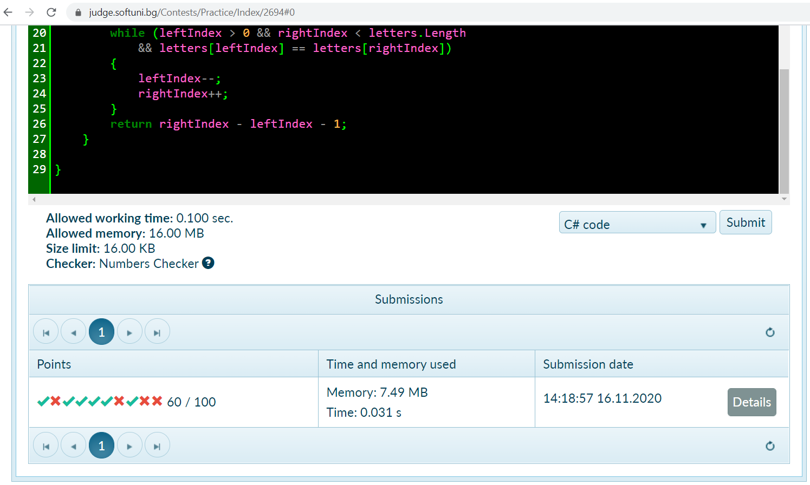
Submit to Judge

Slide 29
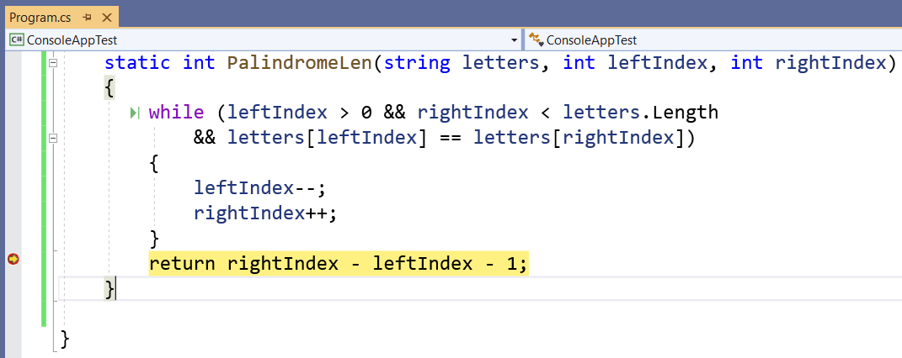
Use the Debugger
Use the debugger, with good input

Slide 30
Bug Fix
int PalindromeLen(int leftIndex, int rightIndex)
{
while (leftIndex >= 0 && rightIndex < letters.Length
&& letters[leftIndex] == letters[rightIndex])
{
leftIndex--;
rightIndex++;
}
return rightIndex - leftIndex - 1;
}

Slide 31
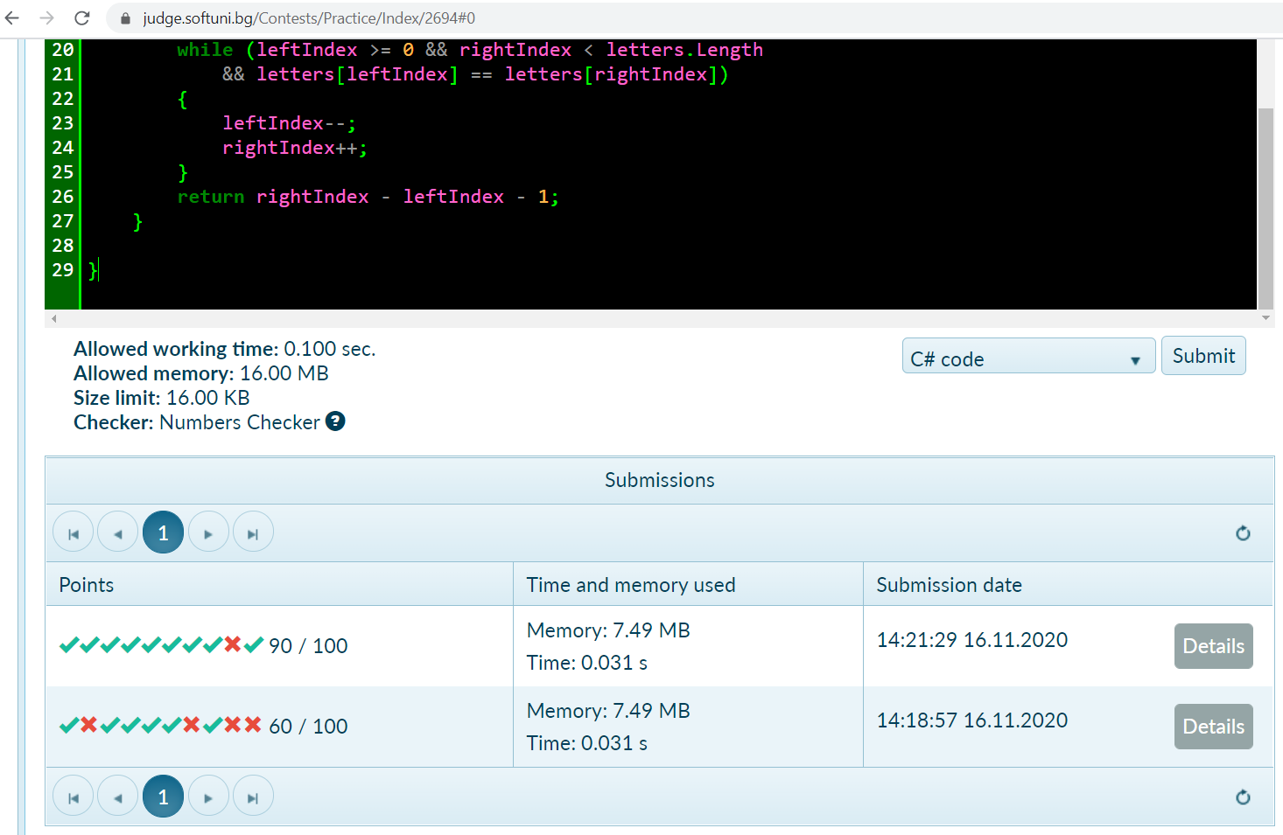
90/100 → Go Ahead or Debug More?

Slide 32
Another Bug Fix
string letters = Console.ReadLine();
int maxLen = 0;
// Check all single letter central points
for (var c = 0; c < letters.Length; c++)
maxLen = Math.Max(maxLen, PalindromeLen(c, c));
// Check all double letter central points
for (var c = 0; c < letters.Length-1; c++)
maxLen = Math.Max(maxLen, PalindromeLen(c, c+1));
Console.WriteLine(maxLen);
Notes:
Now it will be easy to implement the "longest palindrome sub-list" algorithm using the PalindromeLen function.
We read the input list.
We first check all possible single letter central points and we remember the length of the longest palindrome around a single central point.
We invoke the PalindromeLen function, and we pass to it the central point c, as start and end indexes.
Then we check all possible double letter central points and we remember the length of the longest palindrome around a double central point.
We invoke the PalindromeLen function, and we pass to it the central point c and the next point on the right from it, c+1, as start and end indexes.
Finally, we print the result.

Slide 33
Largest Palindrome Sub-List: Review
Review the results
Does this solution work well for all cases? Any edge cases?
Tests, covering the edge cases:
abc, abcd, ab, a → 1
aa, aa0, 0aa, 0aa1, xxaazz, 01aa234 → 2
aaa, aaa0, 0aaa, 0aaa1, 012aaa34 → 3
aaaa, abba, 0abba, xxxx0, 0abba1 → 4
Can we solve this problem better?
Notes:
Now the problem is almost solved: the algorithm is implemented, and the code is written.
We need to review the results, test the code and debug it (if we find bugs) as the next stage of the problem-solving process.
We should answer the following questions:
Does this solution work well for all cases?
Are there any special, edge cases, for which our code fails?
To answer these questions we should test the code.
We need to prepare test data, which covers the straightforward cases and the edge cases.
As absolute minimum, we should test the code with input data, covering the two main straightforward cases:
A case, where the largest palindrome has a single central point.
A case, where the largest palindrome has a double central point.
As edge cases we can consider palindrome on the left side of the input list, on the right side of the input list, and input list consisting of distinct letters (in which the longest palindrome has length of 1).
This is an example of how we can prepare such well-designed test cases, which cover very well the discussed straightforward and edge cases.
We start with a group of test cases consisting of distinct letters:
"a b c", "a b c d", "a b" and "a".
All these cases have their largest palindrome sub-list, consisting of a single letter, and the expected output is 1.
The next group of test cases holds palindromes, consisting of 2 letters, located on the left, in the middle and on the right of the input list:
"a a", "a a 0", "0 a a", "0 a a 1", "a a b b" (which has 2 equal-length palindromes "a a" and "b b") and "0 1 a a 2 3 4".
All these sample input lists should return 2 as the length of the longest palindrome.
All these test cases test the "double central point" scenario.
The next group of test cases is a palindrome, consisting of 3 letters, located on the left, in the middle and on the right of the input list:
"a a a", "a a a 0", "0 a a a", "0 a a a 1" and "0 1 2 a a a 3 4".
All these sample input lists should return 3 as the length of the longest palindrome.
And these test cases test the "single central point" scenario.
We continue by testing with 4-letter palindromes, for example:
"a a a a", "a b b a", "0 a b b a", "x x x x 0", and "0 a b b a 1", which all should return 4 as the longest length of a palindrome.
These 4-letter palindromes will test again the double central point (in less trivial variant than the palindromes of length 2).
We can continue to test further with longer input lists and with longer palindromes, just to be sure the code works well, for example "10 times x" or "20 times x, followed by z".
If all these test cases work correctly, we can consider that our code is well tested and most probably is it correct.
Finally, we should ask ourselves:
Can we solve this problem better?
Are we satisfied with the algorithm, the implementation, the results, the tests performed and all other decisions we made?
I am quite satisfied with this algorithm: it is simple, easy to implement and the fastest from the ideas we initially had.
After all the test cases we executed, we can be convinced that this algorithm and our implementation are working properly, so I am completely satisfied.

Slide 34
Logical Thinking Problem: Nine Dots
Connect all the 9 dots, using only 4 lines
Notes:
Let's start from a classical logical thinking problem: how to connect the 9 dots using only 4 lines.
At the figure we can see the nine dots, staying in a grid 3 by 3.
We want to connect these nine dots using only 4 straight lines, not more.
How to do this?
Think a bit. I will give you a solution later.
This is an example of 4 lines, which attempt to connect the nine dots without a success.
I can draw another example, as well.

Slide 35
Solution: Nine Dots
Let's think outside the box!
What has changed?
Our point of view
Notes:
The "Nine Dots" logical thinking problem: connect the dots, using only 4 straight lines.
Let's think outside the box!
Try these lines:
First line
Second line
Third line
Fourth line
Voila! We connected the nine dots using four straight lines!
What has changed?
We changed our point of view.
It is allowed to place the ends of the lines outside the points. It's not forbidden, but it is not obvious.
Some logical challenges require creative thinking.

Slide 36
Logical Thinking Problem: The Missing Piece
36
Notes:
Another classical logical thinking problem is shown at the screen:
Where goes the missing piece from the above figure?
See the animated transformation of the triangle at the top to the triangle at the bottom.
We have 1 empty square more in the triangle below.
Where it comes from?
Think a bit and try to find a solution yourself.
I will give you hints and my solution later.

Slide 37
The Missing Piece
The gradient of the green hypotenuse is different than the gradient of the red hypotenuse
37
Notes:
The "Missing Piece" logical thinking problem is to find where the missing empty square come from.
This animation reveals the difference between the triangles. Look at them carefully.
The upper figure and the lower figure are not exactly the same.
The upper figure is obviously smaller than the lower.
From this difference comes the missing piece
At the lower figure, the gradient of the green hypotenuse is different than the gradient of the red hypotenuse.
To solve this problem we need logical thinking: if the figure below appears to be the same size as the figure above, but unexpectedly an empty square appears from somewhere, there should be a difference between the two figures.
Logical thinking will tell you "hey, let's compare these figures side by side".
When we compare the figures side by side, the difference become obvious.
Engineering thinking helps us come up with an idea of how to solve this problem.

Slide 38


Logical Thinking Problem: Five Gallons
You are mixing cement and the recipe calls for 5 gallons of water
You have unlimited amount of water (a garden hose)
You only have a 4-gallon bucket and a 7-gallon bucket
Find a method to: measure 5 gallons
?
7 gal
5 gal
4 gal
Notes:
Let's consider another classical logical thinking problem from the software development world.
Measure 5 gallons using a 4-gallon and 7-gallon buckets.
This problem is sometimes given to technical interviews for developers to test logical thinking.
You are mixing cement and the recipe calls for 5 gallons of water.
You have unlimited amount of water (for example, a garden tap with a hose).
The constraint is that you only have a 4-gallon bucket and a 7-gallon bucket.
The problem is to find a method to measure 5 gallons.
You can fill and pour the buckets and use separate containers with unknown volume.
Think and try to find a solution for this puzzle. I will give a sample solution later.

Slide 39
Five Gallons
Fill the 4-gallon bucket
Pour the 4-gallon bucket into the 7-gallon bucket
Fill the 4-gallon bucket
Pour 3 gallons from the 4-gallon bucket into the 7-gallon bucket (until it fills to the brim)
Empty the 7-gallon bucket
Pour the 1 gallon from the 4-gallon bucket into the 7-gallon bucket
Fill the 4-gallon bucket
Pour the 4-gallon bucket into the 7-gallon bucket
We have solved the problem
1 gal
7 gal
0 gal
1 gal
5 gal
0 gal
4 gal
4 gal
39
Notes:
The "Five Gallons" logical thinking problem is about measuring 5 gallons using a 4-gallon and 7-gallon buckets.
If we analyze this problem and play a bit with filling and pouring the water between the given two buckets, we shall discover interesting properties.
We can measure directly 4 gallons and 7 gallons by filling the smaller and the bigger buckets.
We can fill the smaller bucket, pour it into the bigger bucket, then fill the smaller bucket again and partially pour it into the bigger one. This way we can measure 1 gallon, which is equal to 2 times 4 minus 7, which is two small buckets minus one big.
Once we have measured 1 gallon, we can add 4 gallons (the smaller bucket) to it, and this will give us 5 gallons.
Let's see how this happens in practice.
We start from empty buckets. We fill the 4-gallon bucket.
The small and the bigger buckets now hold 4 and 0 gallons, respectively.
We pour the 4-gallon bucket into the 7-gallon bucket.
The buckets now hold 0 and 4 gallons.
We fill the 4-gallon bucket again.
The buckets now hold 4 and 4 gallons.
We pour from the 4-gallon bucket into the 7-gallon bucket until it fills to the brim. We should have poured 3 gallons from the smaller bucket to the larger one.
At this moment, the 7-gallon bucket will be filled to its full capacity and in the 4-gallon bucket will hold 1 gallon.
Nice! We successfully measured 1 gallon. We can use it further to measure different quantities of liquid.
The buckets at this moment hold 1 and 7 gallons, respectively.
Let's continue. We empty the 7-gallon bucket.
The buckets now hold 1 and 0 gallons.
We pour the 1 gallon from the 4-gallon bucket into the 7-gallon bucket.
The buckets now hold 0 and 1 gallons.
We fill the 4-gallon bucket for a third time.
The buckets now hold 0 and 1 gallons.
We pour the 4-gallon bucket into the 7-gallon bucket.
The buckets now hold 0 and 5 gallons.
Voila! We have solved the problem using logical thinking and creativity!

Slide 40

10 Piles of Gold and Counterfeit Coins
You have 10 piles of 10 gold coins
All the coins in one of these piles are counterfeit, and all the other coins are real
A real coin weighs 10 grams
A counterfeit coin weighs 11 grams
You can use an extremely accurate digital weighing scale only once
How do you determine which set of 10 coins is faulty?
Notes:
I want to give you another classical logical thinking problem for software developers.
Find the counterfeit pile of coins among 10 piles of 10 coins.
This problem is quite interesting, because it is sometimes given to technical interviews for software engineering jobs to test logical and engineering thinking.
Let's explain the problem in detail:
You have 10 piles of 10 gold coins each.
All the coins in one of these piles are counterfeit, and all the other coins are real.
It is unknown which is the faulty pile, but it is guaranteed that it is exactly one of the piles.
Each real coin weighs 10 grams, exactly 10 grams.
Each counterfeit coin weighs 11 grams, exactly 11 grams. Fake coins are heavier.
You can use an extremely accurate digital weighing scale only once.
You are only allowed to measure the exact weight of something and that's it.
You cannot use the weighing scale more than once! Only one measurement is allowed.
You most probably need to take some of the coins and measure their weight and this should be enough to solve the problem.
The problem is to find a method to determine which set of 10 coins is faulty, by using only one measurement.
Think and try to find a solution for this puzzle. I will give a sample solution later.

Slide 41

10 Piles of Gold and Counterfeit Coins
We take 1 coin from pile #1, 2 coins from pile #2, 3 coins from pile #3 and so on, up to 10 coins from pile #10
Total 55 coins: if real ➔ weight = 550 g
However, some will be counterfeit
41
Notes:
The "10 Piles Gold and Counterfeit Coins" problem is about finding the pile, which holds the counterfeit coins among the piles, which hold gold coins.
We are given 10 piles, each holding 10 coins.
One of the piles holds counterfeit coins: 10 coins, each 11 grams, total 110 grams.
The other 9 piles hold real gold coins: 10 coins, each 10 grams, total 100 grams.
We don't know which pile is fake. It can be this or this or this. All the piles look the same.
We can measure the weight of something only once. How to find the fake pile?
Let's analyze the problem:
We have 9 gold piles, each 100 grams (10 coins by 10 grams) + 1 fake pile of 110 grams (10 coins by 11 grams).
We want to find which are the gold and the fake piles.
We can measure the weight of something only once.
This is the tricky moment. Why exactly once?
If we can measure many times, we can measure each pile and find the fake (it weighs 110 grams).
But we should use only one measurement. Only one.
We should somehow measure all the piles together.
We need to build a combination of coins from all the piles and measure them together, because if we ignore some piles, the counterfeit may be among them and we will not be able to solve the problem using just one measurement.
But if we build a combination of piles how do we recognize which coin comes from which pile?
Here we need creative solution.
We build a combination of coins by taking 1 coin from pile #1, 2 coins from pile #2, 3 coins from pile #3 and so on, up to 10 coins from pile #10.
We have a total of 55 coins. If all the coins are real, they will weigh 550 grams together.
However, some coins will be counterfeit. And we can measure the total weight of all the coins together, and we can find which pile is fake. Let's see how.

Slide 42


10 Piles of Gold and Counterfeit Coins
We weigh all the coins together using the scale
It reads, for example, 553 g
The difference is: 553 – 550 = 3 g
We have 3 counterfeit coins
These are the coins from the pile #3
Conclusion: pile #3 is counterfeit
42
Notes:
We weigh all the coins together using the weighing scale.
It reads, for example, 553 grams.
The difference is: 553 – 550 = 3 grams.
If all the coins were real gold, they would weigh 550 grams.
But the measurements shows a difference of 3 grams.
We can conclude that we have 3 counterfeit coins, because each counterfeit coin adds to the total weight 1 gram (counterfeit coins weigh 11 instead of 10 grams).
Therefore, these are the coins from the pile #3.
The fake pile is #3, which holds 3 coins, weighing 33 grams.
The other 9 piles, holding the other 52 coins, are real, and their weight is 520 grams.
33 grams (the weight of the counterfeit coins) + 520 grams (the weight of the real coins) = 533 grams (the total weight)
Conclusion: pile #3 is counterfeit
If we had 7 counterfeit coins (which come from the pile #7), the difference would be 7, right?
In the same way, if we had 4 counterfeit coins (from the fake pile #4), the difference would be 4.
You can check yourself that this algorithm will work for any fake pile from #1 to #10.

Slide 43

Summary
The stages of problem solving:
Define the problem (requirements)
Analyze the problem (deep understand)
Identify potential solutions (ideas)
Evaluate and choose the best solution
Algorithm design (action plan)
Implement and review results
…
…
…
Notes:
Now let's summarize what we learned from this lesson.
The main stages of problem solving are:
Define the problem: establish clear requirements.
Analyze the problem: find interesting properties and facts about the problem that can help you find a solution.
Identify potential solutions: generate ideas (by sketching on a squared paper), test the ideas and evaluate their correctness, strengths and weaknesses.
Evaluate and choose the best solution: compare the potential solutions from your ideas, evaluate their pros and cons and choose the best one, which you want to implement.
Algorithm (action plan): design an algorithm based on your selected idea. Write down the algorithm step by step.
Implement and review results: implement the algorithm, run your code and test it well. Check the straightforward case and the edge cases.

Slide 44
Questions?
Notes:
If you have any questions, please feel free to ask.
44

Slide 45












SoftUni Diamond Partners

Slide 46


Educational Partners

Slide 47

License
This course (slides, examples, demos, exercises, homework, documents, videos and other assets) is copyrighted content
Unauthorized copy, reproduction or use is illegal
© SoftUni – https://about.softuni.bg
© Software University – https://softuni.bg
Notes:
47

Slide 48
Trainings @ Software University (SoftUni)
Software University – High-Quality Education, Profession and Job for Software Developers
softuni.bg, about.softuni.bg
Software University Foundation
softuni.foundation
Software University @ Facebook
facebook.com/SoftwareUniversity
Software University Forums
forum.softuni.bg
Notes:
48

